Slide 1
CSEP504: Advanced topics in software systems
Catching up on some things – interspersed
Structured reports
State-of-the-research reports
Topic #3
Tonight: first of three lectures on software tools and environments
Main roles of tools and environments – absolutely incomplete
Historical overview – absolutely incomplete
Opportunities – absolutely incomplete
David Notkin  Winter 2010  CSEP504 Lecture 4
Notes:
Lecture 1: Tools & Environments (roles and historical perspectives) - What are the main roles of tools in our development process? - Understanding - Building - Modifying - Debugging - Testing - Historical overview of how we got to here: - (Wouldn't bother with pre-basic editors) - text editors galore - emacs & other syntax-aware editors - semantically-aware editors (e.g. pascal) - smalltalk - modern environments (visual studio, eclipse, etc) - What new development approaches will _require_ specific tools? - Modelling - SMT stuff from 590N seminar (incl verifying protocols)

Slide 2
Last week
Many thanks to Yuriy for lecturing
Visited Georgia Tech, College of Computing
Member of dissertation committee
Colloquium

Slide 3
What is a tool?
lowes.com (1/31/2010) lists 4622 tools (power tools, hand tools, electrical tools, etc.)
“1. a device or implement, typically hand-held, used to carry out a particular function. 2. a thing used to help perform a job • a person exploited by another.”
"tool n." The Concise Oxford English Dictionary, Twelfth edition . Ed. Catherine Soanes and Angus Stevenson. Oxford University Press, 2008. Oxford Reference Online. Oxford University Press. University of Washington. 31 January 2010 <http://www.oxfordreference.com/views/ENTRY.html?subview=Main&entry=t23.e59094>
We’ll focus on software tools – that is, programs that help programmers develop programs
Programs that help non-programmers (or programmers) develop non-programming artifacts –word processors for writing a book, …
Other tools that help programmers develop programs – pencil & paper, whiteboards, information hiding, …

Slide 4
What environments and tools do you use?

Slide 5
Wikipedia: computer programming tools 29 subcategories (1/31/2010)
Bug and issue tracking software (42 pages)
Build automation (37)
Code navigation tools (1)
Code search engines (11)
Compilers (65)
Computer-aided software engineering tools (15)
Debuggers (2)
Disassemblers (4)
Discontinued development tools (5)
Documentation generators (17)
EXE packers (2)
Formal methods tools (17)
Free computer programming tools (25)
GUI automation (37)
Integrated development environments (143)
Java development tools (67)
Microsoft development tools (44)
Profilers (17)
Program testing tools (50)
Programming language implementation (58)
Revision control systems (27)
Static code analysis (58)
Text editors (38)
UML tools (26)
Unix programming tools (58)
User interface builders (16)
Web Services tools (2)
Web development software (57)
Computer programming tool stubs (124)

Slide 6
What was the first computer?

Slide 7
Analytical Engine(s)
[Material and photographs from the Computer History Museum web site and Wikipedia]
Charles Babbage’s (1791-1871) Analytical Engine is “much more than a calculator and marks the progression from the mechanized arithmetic of calculation to fully-fledged general-purpose computation.”
The logical structure had a separation of the memory (the 'Store') from the central processor (the 'Mill'), serial operation using a 'fetch-execute cycle', and facilities for inputting and outputting data and instructions
1,000 numbers of 50 decimal digits each

Slide 8
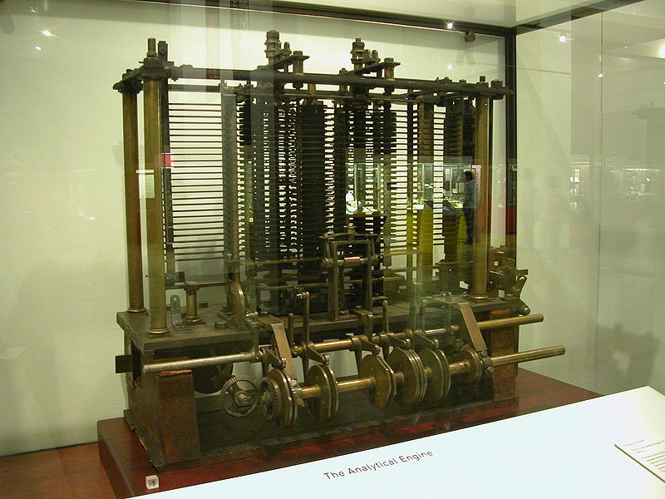
http://commons.wikimedia.org/wiki/File:AnalyticalMachine_Babbage_London.jpg {{Information |Description = Machine Analytique de Charles Babbage, exposée au Science Museum de Londres Date = 5 Mai 2009 |Auteur = Bruno Barral |Permission = CC-BY-SA-2.5}}

Slide 9
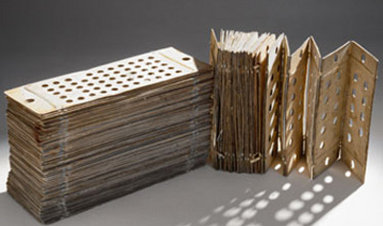
Programming the Analytical Engine
Programmable using punched cards
Idea borrowed from the Jacquard loom used for weaving complex patterns in textiles
The programming language had loops and conditional branching
Was Turing-equivalent (before Turing)
Three different types of punch cards used: arithmetic operations, numerical constants, load and store operations

Slide 10
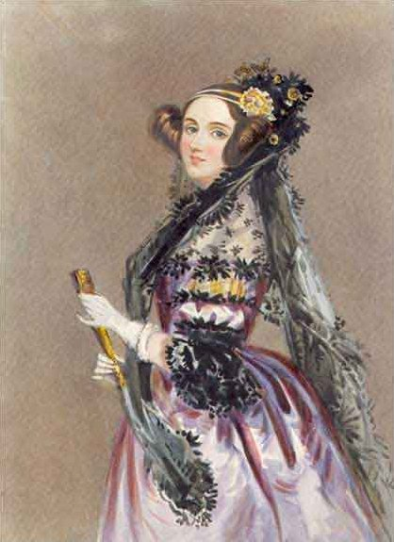
Ada Lovelace: the 1st programmer
She wrote a method for calculating a sequence of Bernoulli numbers
It would have run correctly (had the Engine ever been built)
Babbage called her the “Enchantress of Numbers”
Died in 1852 at 37 years-old

Slide 11
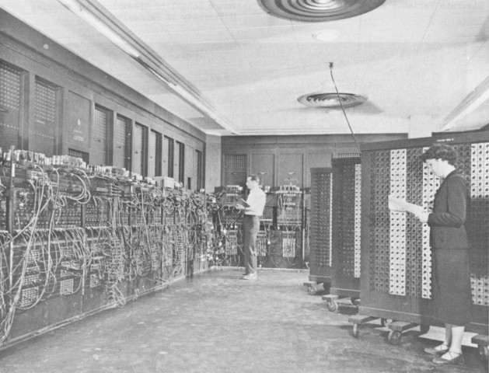
ENIAC [http://www.computersciencelab.com]
“C” is for …? Why?
Mauchly-Eckert at Penn in 1943-45
Circ := 3.14 * diam
Rearrange many patch cords, locate and set three specific knobs to 3, 1, 4
20’x40’, 30 tons, more than 18K vacuum tubes
Held 20 numbers
0.0028th second for a multiply, 100K cycles/sec
The first ENIAC program remains classified

Slide 12
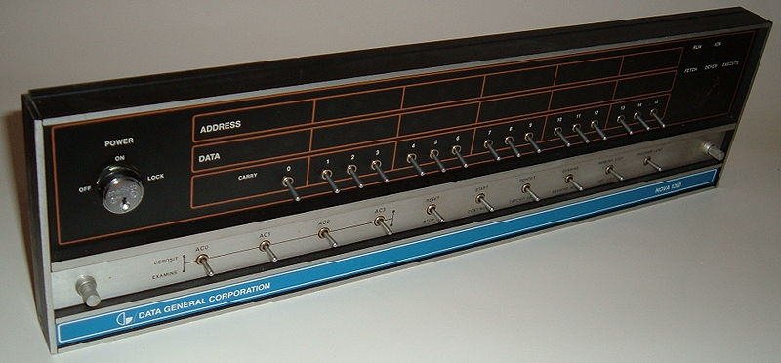
Data General Nova
This file is licensed under the Creative Commons Attribution-Share Alike 3.0 Unported license
This file is licensed under the Creative Commons Attribution-Share Alike 3.0 Unported license http://commons.wikimedia.org/wiki/File:Nova1200.agr.jpg

Slide 13
The point: what’s expensive?
As people (“producing the software”) become more expensive relative to the computer (“producing the hardware”), people productivity becomes more critical

Slide 14
My view
Successful software tools are designed with an excellent understanding of what computers do well and what people do well
Unsuccessful tools generally make a mistake in at least one of these dimensions
The “what computers do well” dimension surely shifts over time
Faster, bigger and cheaper computers
Better algorithms, interfaces, ideas, etc.
The “what people do well” dimension shifts much less slowly over time
However, as the cost of quality people increases, the ratio changes as well

Slide 15
Interlude
Structured reports – questions, concerns?
Yes, Virginia, there is a discussion board
State-of-the-research reports
We’ll announce turn-in and commenting mechanism soon
If there has been one confusion, it has been on how arbitrary the topic can be

Slide 16
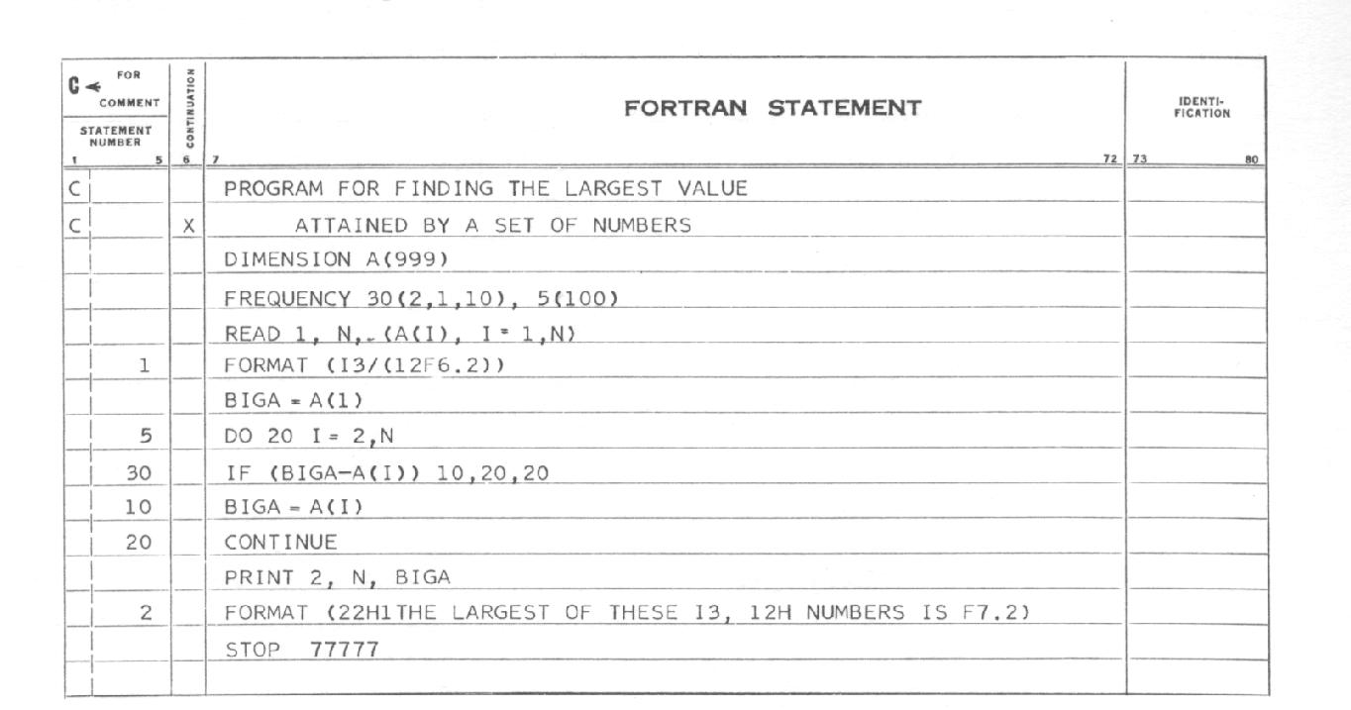
Non-interactive programming
Interactive programming would have been a poor early use of computer time
Programming 1960’s mainframes was often done by programmers filling in coding forms, with keypunch operators then entering the code – programmers cheaper than computers, keypunchers cheaper than programmers
http://www.fortran.com/ibm3.jpg

Slide 17
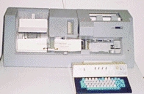
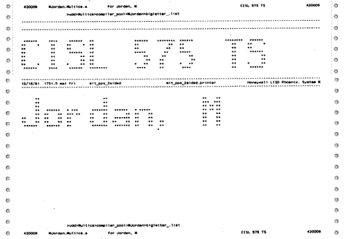
Keypunch
IBM 029 – 1960’s and 1970’s
“Ah, yes, but the real trick is fixing a variable name when you've left out a letter. You could jam one card in place, and either type or space to move the other, then continue duplicating.”
Conversations from the Old Programmers' Home http://www.firelily.com/humor/programming/old.prog.html
Debugging from listings
No modifying structure
No search
No stepping through code
…
Counterpoint: more thinking
http://www.multicians.org/mulimg/headpage.gif

Slide 18
High-level languages and compilers
High-level languages were questionable because of difficulties in developing compilers
There was a lack of theory, a lack of experience, limited memory capacity, and no lessening of performance demands
As porting software to new architectures became more frequent, assembly languages became increasingly limiting – technology was developed that enabled compilers
Nice feedback loop between new architectures, high-level languages, compiling techniques, bootstrapping, etc.

Slide 19
Interactive editing: line editors
No window or screen display of content
Short commands that minimized typing
Search and (usually) random-access to lines
Localized modifications (e.g., fix typos)
Repeated modifications (e.g., change variable name)
Search/replace initially based on simple matching, later on regular expressions
Significant improvement on keypunches

Slide 20
Interactive editing: screen editors
Video screens enabled screen editors
Indeed, screen editors and resulting productivity arguably increased the market for video screens
Provided visible context – not only a cursor, but a cursor in context of a sequence of lines of data
vi – screen version of ed, still in use
Customizable/programmable (e.g., macros) – TECO, emacs, …
But compiling, running, etc. was still a batch process

Slide 21
Emacs: MIT AI Lab (from emacswiki)
1972: display (screen) editing added to TECO
1974: Stallman added macros to TECO
1976: Stallman combined scads of macros into a single command set and an extensibility mechanism – “Editor MACrosS”
1978: Bernard Greenberg wrote MulticsEmacs (at Honeywell) in MacLisp, including user extensions
1981: Gosling Emacs, the first variant to run on Unix, written in C with MockLisp for extension
1984: Stallman started GNU Emacs

Slide 22
Emacs feature: extensibility
Add libraries/packages/extensions
Extensions turn Emacs into an environment in which programmers edit, compile, and debug code using a single interface
And many more not specifically related to programming – calculators, calendars, document processing support (TeX, LaTeX), web browsing, email, chat clients, online help, spreadsheets, etc.

Slide 23
Emacs feature: customizability
Simple setting of common customization variables such as the color scheme
Defining keyboard macros
.emacs startup files that set variables, set key bindings, etc.
Many people have huge .emacs files with wildly idiosyncratic customizations

Slide 24
Emacs feature: editing modes
“Major modes” to provide convenience for text, for most programming languages, for HTML, for TeX/LaTeX, etc.
Syntax highlighting using different fonts or colors
Automatic indentation
“Electric” features such as automatic insertion of elements such as spaces, newlines, and parentheses
Special editing commands like commands to jump to the beginning and the end of a function
“Minor modes” to support (for example) different indentation styles within the C “major mode”

Slide 25
Emacs features: other
Performance
Portability
Self-documenting
Manuals
…

Slide 26
Editors: discussion

Slide 27
Interpreters
Interactive access to computers enabled interpreters
Tend to reduce time-to-execute (-test)
Tend to make finding bugs and fixing them easier than for compiled languages
Also expanded the number of programmers and the variation in their background (and possibly their ability)
BASIC (Kemeny/Kurtz ‘83) principles
Easy for beginners (students, non-science and non-math focus)
General-purpose programming language
Allow advanced features to be added for experts
Interactive
Good error messages
Quick response
Allow programmers to remain unaware of hardware and OS

Slide 28
Debuggers
In 1945, a moth was found trapped in and then removed from Harvard’s Mark II Aiken Relay Calculator
The operator entry said this was the “first actual case of bug being found” and that they had successfully "debugged" the problem
Features of debuggers include breakpoints, tracing, watchpoints, examining and set variables, examining the callstack, …

Slide 29
Interactive Fortran (circa 1969) N. Rawlings (©1995-2007 Computer History Museum)
FDEBUG
modifications to compiler (to keep the symbol table)
modifications to the operating system (to insert illegal instructions, give control to the debugger/user, etc.)
Programmers could set breakpoints, conditional breakpoints, change variable values, etc.
“This was brilliant and it was a huge breakthrough in the ease of debugging Fortran programs. No one else matched it for years! Worldwide! Before then, the program had to change in order to debug it – and that change often moved the bug one was trying to isolate.”

Slide 30
Sequence of Unix debuggers
adb – absolute debugger, essentially symbolic access at the assembly language level
dbx (1981, Linton) – symbolic, multiple languages supported, etc.
gdb, DDD – “modern” dbx and screen-based debuggers

Slide 31
Windows debuggers?

Slide 32
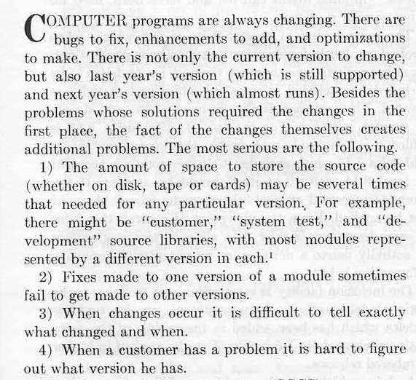
Source code control tools
AKA revision control, version control, source code management, …
SCCS, Marc Rochkind, IEEE Transactions on Software Engineering SE-1:4 (Dec. 1975). – first ICSE N-10 Most Influential Paper recipient

Slide 33
Post-SCCS…
RCS (~backward deltas)
CVS (~client-server based RCS)
SVN (~”improvement” on CVS)
ClearCase (~versions supported below application level)
Then came distributed revision control systems
Arch, Monotone, BitKeeper, Git, Bazaar, …

Slide 34
Distributed revision control
Multiple “central” repositories permitted
Most operations don’t require network access
Allows different structures of authority, perhaps better suited for open-source projects
Not reliant on a single machine
Concepts are not as simple to grasp

Slide 35
Source code control: discussion

Slide 36
Other tools
Testing tools
Bug databases
…
…others?

Slide 37
Final two lectures: suggestions
Software testing
Discussion of papers in groups
Design patterns
Here’s what I think I want
One lecture on software engineering economics [me]
One lecture used for presentations on your state-of-the-research reports [you]
But we don’t likely have time for every person or group to present (even 10 minutes/presentation lets us do at most 15 in one evening)
An alternative idea: an all-at-UW poster session evening, with people asking and answering questions on these papers
Last suggestions by Wednesday, and then I’ll decide

Slide 38
Roles of tools
What aspects of the software lifecycle do they address? Can they address? Should they address?
Waterfall
Requirements
Design
Implementation
Verification/Testing
Maintenance
Testing
Debuggers
Editors
Notes:
Understanding
Building
Modifying
Debugging
Testing

Slide 39
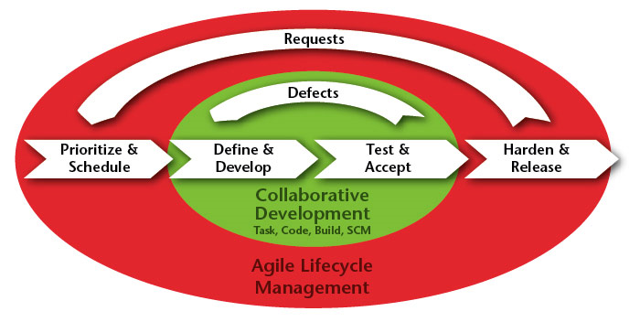
Roles of Tools
Version control
Agile
Major addition from waterfall
© 2010 Rally Software Development Corp
http://www.rallydev.com/agile_products/lifecycle_management/

Slide 40
Tools and environments
Interaction and rich user interfaces
Translation of high-level descriptions
Maintaining consistency among large and complex representations
Encoding knowledge about an activity, organization or process
Broader availability of pertinent information
Communication medium
…
Understanding
Building
Modifying
Debugging
Testing
…
X

Slide 41
Environments vs. tools
Degree of focus on a single task vs. a set of tasks
Degree to which the user interacts in a uniform way
Degree to which the user is responsible for managing consistency
Degree to which there is a shared representation

Slide 42
Why environments? 30 years ago
“During the past decade there has been a growing realization [that software tools] have by and large failed to reduce cost and improve quality. … [T]he essence of an environment is that it attempts to redress the failures of individual software tools through synergistic integration.” Osterweil, 1981
“Current software development environments often help programmers solve their programming problems by supplying tools such as editors, compilers, and linkers, but rarely do these environments help projects solve their system composition or management problems.” Notkin & Habermann, 1979
“A software development environment consists of a set of techniques to assist the developers of software systems, supported by some (possibly automated) tools, along with an organizational structure to manage the process of software development. Historically, these facilities have been poorly integrated.” Wasserman, 1981

Slide 43
Done deal
There is little doubt that users prefer integrated tool sets
This can come from integrated development environments like VisualStudio or Eclipse – along with extensions
This can come from aggressive extensions of tools like Emacs
Although the engineering and the “feel” may be different, there seems to be little question that blurring the edges of editor, compiler, debugger, source code control, etc. is generally preferred

Slide 44
Unix: toolkit-based environment
Simple integration mechanism
Convenient user-level syntax for composition
Standard shared representation
Language-independent (although biased)
Efficient for systems’ programming

Slide 45
Interlisp (Xerox PARC)
Started in 1967 at BBN as BBN Lisp
Moved to Xerox PARC with Bobrow, Teitelman and others and became Interlisp
Lisp machines were developed and sold InterLisp-D.
The environment was notable for the integration of interactive development tools – debugger, DWIM, etc.
Very fast turnaround for code changes
Monolithic address space
Environment, tools, application code commingled
Code and data share common representation

Slide 46
Teitelman and Masinter, 1981
“From its inception, the focus of the Interlisp project has been not so much on the programming language as on the programming environment. … The programmer's environment influences, and to a large extent determines, what sort of problems he can (and will want to) tackle, how far he can go, and how fast. If the environment is cooperative and helpful (the anthropomorphism is deliberate), the programmer can be more ambitious and productive. If not, he will spend most of his time and energy fighting a system that at times seems bent on frustrating his best efforts.”
“The second major influence in Interlisp's development was a willingness to ‘let the machine do it.’ The developers were wiling to expend computer resources to save people resources because computer costs were expected to continue to drop.”

Slide 47
Features
DWIM – Do What I mean
The system detects errors attempts to guess what the user might have intended – a “pervasive philosophy of user interface design”
The environment as an agent of the programmer – the programmer’s assistant
MASTERSCOPE
For analysis and cross-referencing
Information about function calls and variable usage

Slide 48
Smalltalk-80 (Xerox PARC)
Alan Kay and others at Xerox PARC
Language and environment – largely indivisible
Pure OO, dynamically-typed, reflective – metaclasses to make “everything an object”
Environment structured around language features – class code browser/editor, protocols, inspectors, notifiers, etc.
Rich libraries (data structures, UI, etc.)

Slide 49
Cedar (Xerox PARC)
Intended to mix best features of Interlisp, Smalltalk-80, and Mesa
Primarily was an improvement on Mesa
Language-centered environment
Abstract data type language
Strong language and environment support for interfaces
Key addition: garbage collection

Slide 50
Some illustrative research environments

Slide 51
Toolpack (Osterweil, 1983)
Consider breadth of tools needed for software development (static analysis and testing tools, documentation, etc.)
“Tool fragments” to support tight integration of tools into an environment
Centralized tree-structured file system for sharing data
Focus on mathematical software

Slide 52
Gandalf (Habermann, Notkin, et al.)
Structure-based environments
Direct-manipulation of program objects – intent was to decrease the gap between the programmer and the compiler through sharing the abstract syntax tree
Environment generation – to allow multiple language support
Integration through implicit invocation by active abstract syntax trees
Shared database structured on ASTs

Slide 53
Initial IPE: Medina-Mora & Feiler 81
“The integration of the tools allows IPE [interactive programming environment] to present the programmer with a uniform view of the program in terms of its source form. The program is manipulated through a syntax-directed editor, and its execution is controlled by a language oriented debugger. The debugging actions are embedded in the supported language and are invoked by editing the program. … [The] tools and their representation are not visible to the user, the only (thus uniform) interface is the user interface of the editor.”

Slide 54
Mentor
Donzeau-Gouge, Huet, Kahn, Lang, Levy, 1984
Structure-based environment
Users could define dynamic views
General-purpose tree manipulation language
Formal basis for semantic definition
Led to Centaur generation system
Used natural semantics

Slide 55
Cornell
Program Synthesizer [Teitelbaum & Reps, 1981]
Syntax-based editing environment
Text at expression-level
Synthesizer Generator [Reps & Teitelbaum, 1984]
Generation of syntax-based editors
Based on definition of attribute grammars
Incremental attribute grammar update algorithm [Reps 1983]

Slide 56
Structure-oriented editors
These failed because they
unnecessarily and overly constrained the users
one editor, one style
hard to integrate external tools
not bad for novice environments
tried to reduce the wrong cost
getting syntax (and static semantics) right isn’t such a big deal
costly to produce (even after tons of research)

Slide 57
Structure-oriented editors
Some language-oriented features have flourished
Every successful program editor now encodes knowledge about the programming language syntax and often semantics
Language-knowledgeable refactoring is a part of editors now – this requires a richer representation than text alone
Some commands – like “compile” – are largely disappearing (something Gandalf aspired to 30 years ago)

Slide 58
Arcadia (R. Kadia, 1992)
Process-based environment
Process definition and execution
Analysis and testing
Measurement and evaluation
UI development and management
Event-based integration
Typed object-base

Slide 59
Pecan (Reiss, 1984)
Graphically-based environment
Multiple, concurrent views
Data structures
Symbol table
Flowchart
Nassi-Shneiderman diagrams
Many views read-only

Slide 60
Desert (Brown, Reiss)
Single editor and lightweight data integration through fragments
Ability to dynamically jump among logically connected files, and the ability to create and edit virtual files, files that contain information relevant to the current task extracted from all over the system.

Slide 61
Intentional Programming (http://intentsoft.com/)
Charles Simonyi – first at Microsoft/MSR
High-end domain-specific programming – exploit both knowledge and notation from specific domains
Some domains are claimed as successes – some European financially-oriented efforts, for example
“Traditional” programming is not, but then again the goal is to reduce or eliminate that, not to support it

Slide 62
Endeavors (UCI, Taylor & Redmiles)
An open, distributed, extensible process execution environment
Designed to improve coordination and managerial control of development teams by allowing flexible definition, modeling, and execution of typical workflow applications

Slide 63
Some myths: environments
Integration is job #1
Integrating tools helps, but only if the tools are the “right” tools
That is, integration is a second order effect, not a first order effect
This also suggests that extensibility, replaceability, etc. are crucial because the “right” tools necessarily change over time
Graphics inherently dominate text – “A picture is worth a thousand words”
Screen real estate
Sharing with other tools
Sharing with other people

Slide 64
Some myths: CASE & environments
Goal should be to change how software engineering is done
No, it should be to enhance how people are doing software engineering
The tools can handle creative aspects of software engineering
Tools frequently fail to be useful because they make poor judgments about what the human does well and what the computer does well

Slide 65
Modern IDEs
“Eclipse started as a Java IDE, but has since grown to be much, much more. Eclipse projects now cover static and dynamic languages; thick-client, thin-client, and server-side frameworks; modeling and business reporting; embedded and mobile; and, yes, we still have the best Java IDE.” http://www.eclipse.org/projects/
Microsoft Visual Studio is an IDE that supports development of programs for virtually all Microsoft platforms. Framework is language-independent, with plug-in structures to specialize the environment to given languages, source code control systems, etc.

Slide 66
Eclipse architecture
Lightweight plug-in mechanism on top of a run-time system supports extensibility, integration and uniformity
The IDE has an incremental Java compiler and a full model of the Java source files, enabling plug-ins for language syntax and semantics
Tools plug-ins (984)
Application Management (46)
Application Server (17)
Build and Deploy (54)
Code Management (51)
Database (32)
Database Persistence (3)
Documentation (27)
Editor (90)
Entertainment (9)
Graphics (16)
IDE (113)
J2EE Development Platform (25)
J2ME (11)
Languages (62)
Logging (4)
Modeling Tools (81)
Mylyn Connectors (8)
Network (10)
Other (41)
Process (19)
Profiling (14)
Reporting (5)
Rich Client Applications (12)
SCM (13)
Search (3)
Source Code Analyzer (57)
Systems Development (16)
Team Development (52)
Testing (61)
Tools (215)
UI (58)
UML (37)
Web (43)
Web Services (16)
XML (16)

Slide 67
Platform components
Ant Eclipse/Ant integration
Core Platform Runtime and resource management
CVS Platform CVS Integration
Debug Generic execution debug framework
Releng Release Engineering
Search Integrated search facility
SWT Standard Widget Toolkit
Team/Compare Generic Team & Compare support frameworks
Text Text editor framework
User Assistance Help system, initial user experience, …
UI Platform user interface
Update Dynamic Update/Install/Field Service

Slide 68
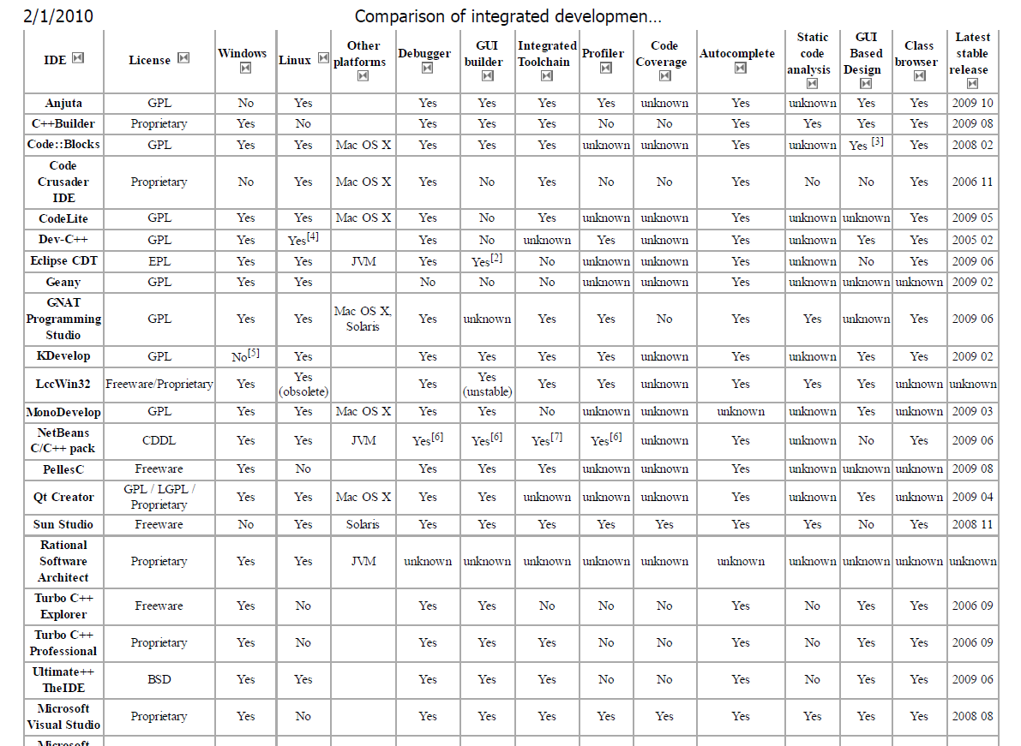
Wikipedia: truncated C/C++…

Slide 69
Visual Studio
A code editor, with IntelliSense (a modern-day DWIM) and refactoring
Integrated source- and machine-level debuggers
Support for GUI, web and database design
Can add plug-ins for domain-specific languages and tools for other aspects of the lifecycle

Slide 70
Distributed software development
What tools are needed?

Slide 71
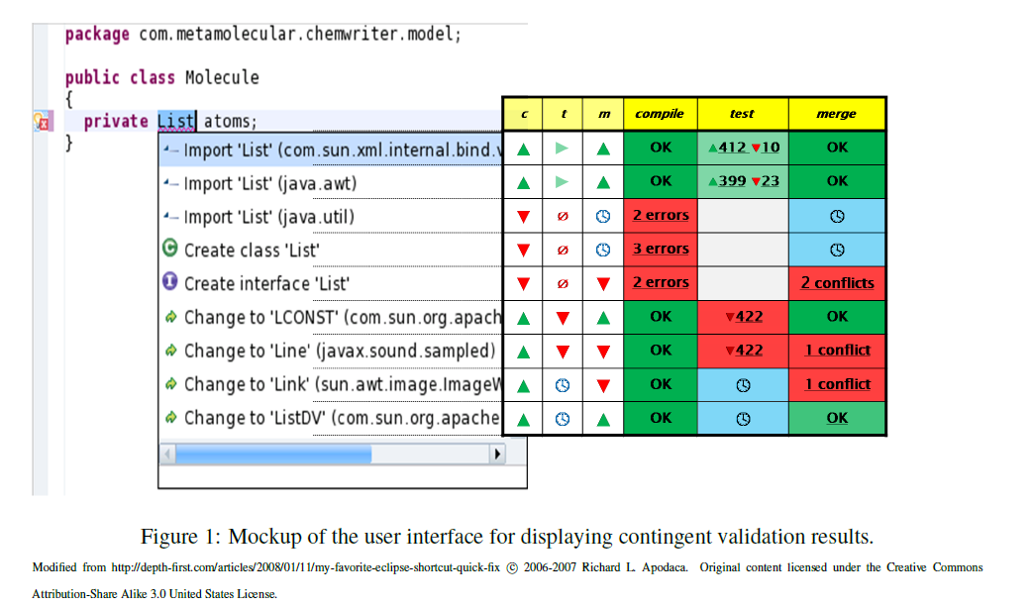
Speculation: ongoing research @ UW

Slide 72
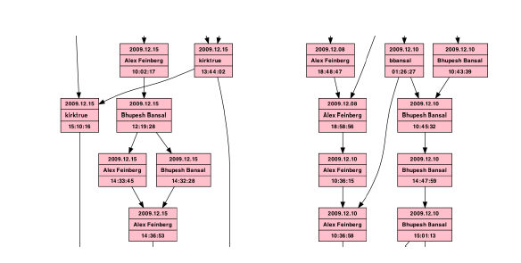
Speculation over merging?

Slide 73
Next two lectures (no lecture 2/15)
Next week
A few tools in some more depth: likely candidates include reflexion models, continuous testing, concolic testing, delta debugging, …
February 22 (Reid Holmes): Future directions and areas for improvement
Rational behind the drive towards integration
Capturing latent knowledge
Task specificity / awareness
Supporting collaborative development

Slide 74
Questions?

